Slide 1
Vision and Cognitive Systems
Project for Gallerie Estensi Museum
Group n. 26
Luca Denti, Cristian Mercadante, Alberto Vitto

Slide 2
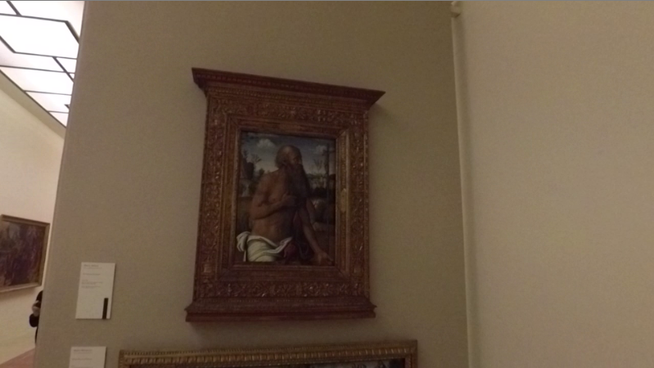
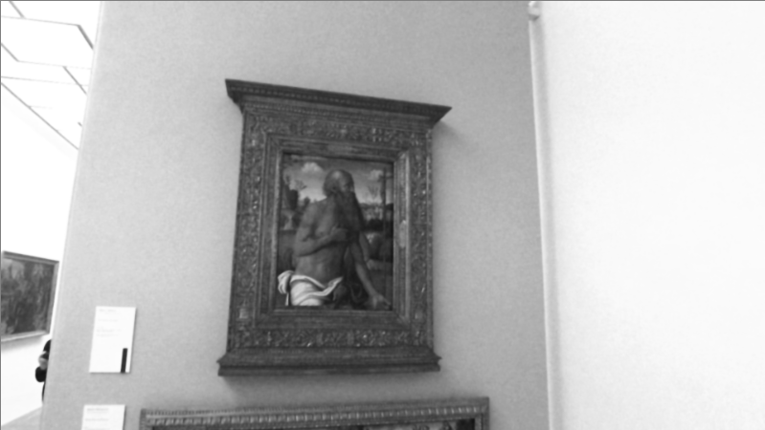
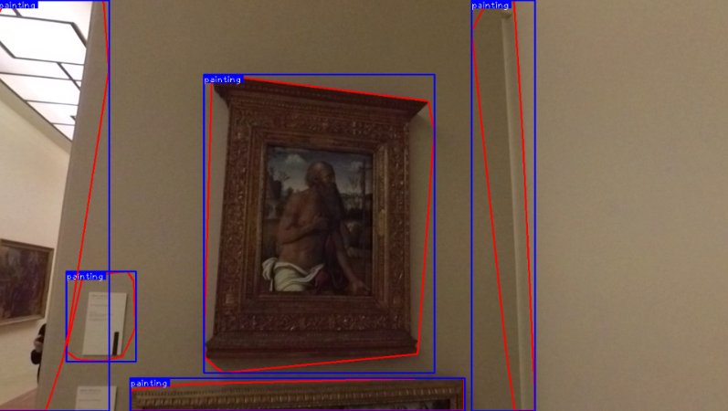
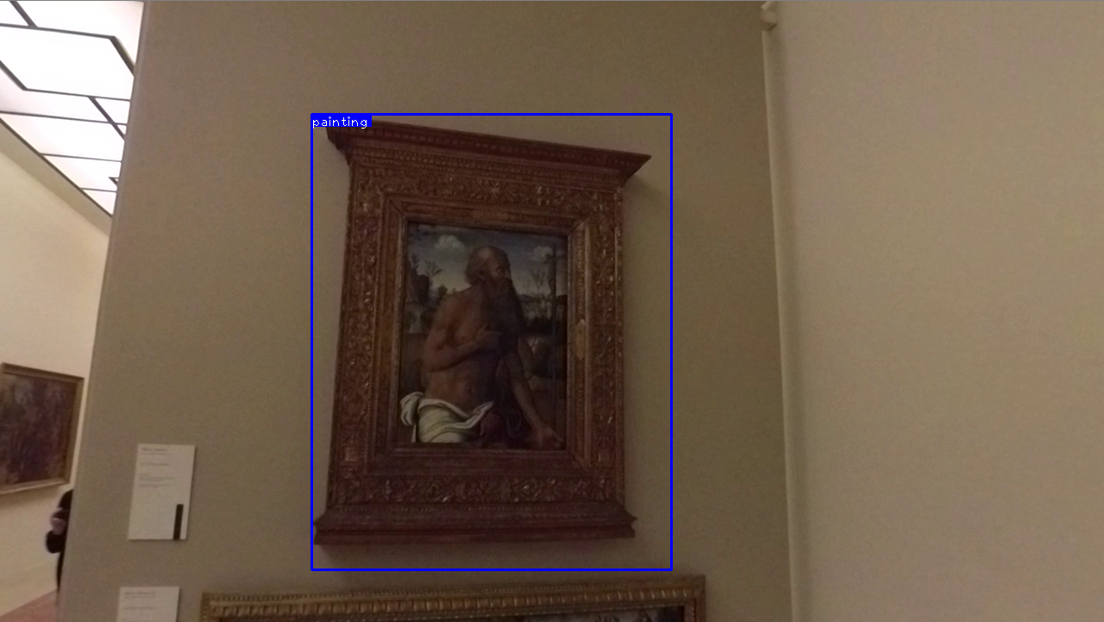
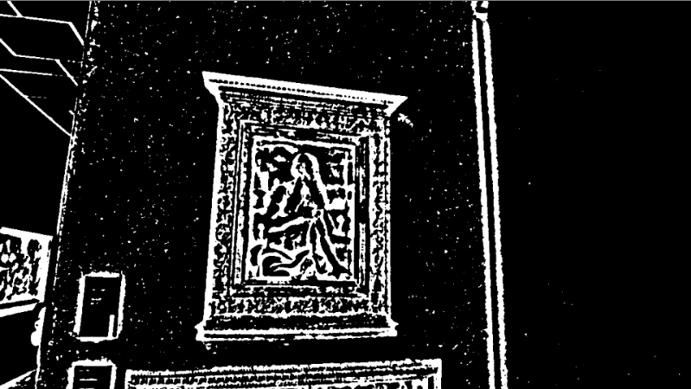
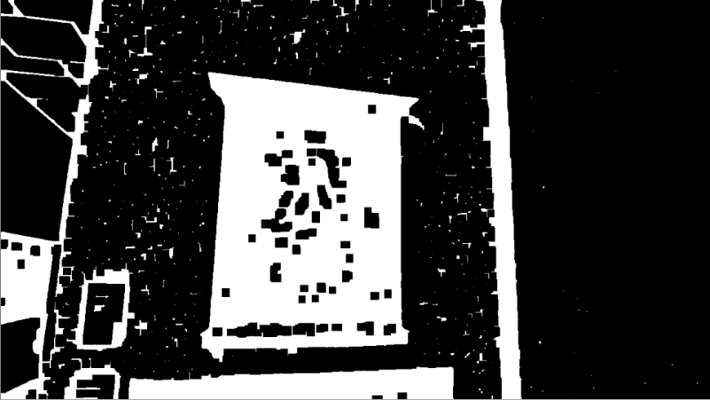
Painting detection
brightness and contrast enhancement
Step 1
grayscale
bilateral filter
adaptive threshold
morphology
is painting?
Step 2
candidate contours
yes
painting contours
no
discard
Notes:
Painting detection pipeline has 2 steps:
step 1 => candidate paintings contours
step 2 => discard not-paintings contours
In step 1, we used …, bilateral filter (in order to eliminate some noise while preserving the edges), adaptive threshold and closing operator (in order to obtain a binary image on which the contours could be better retrieved)
Then, for each contour the system makes some checks (that we will see in the next slide) in order to discard the false positives.

Slide 3
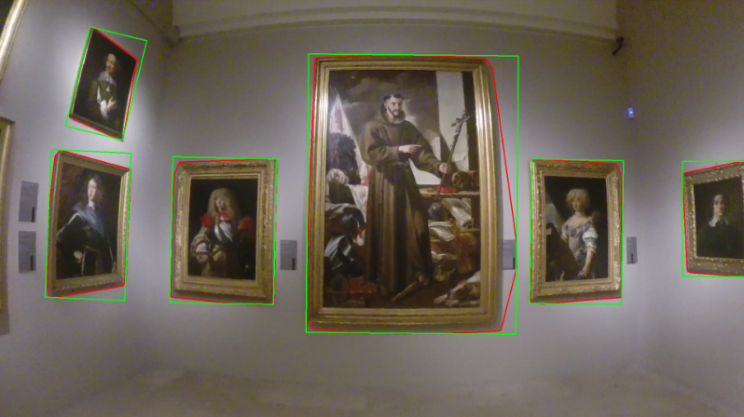
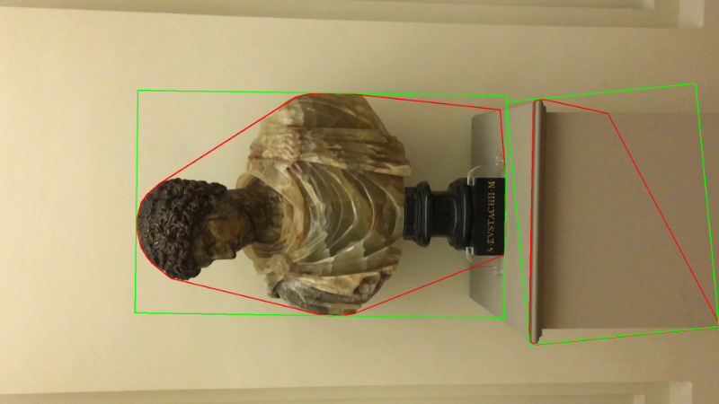
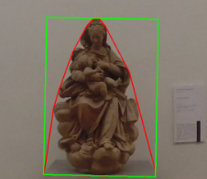
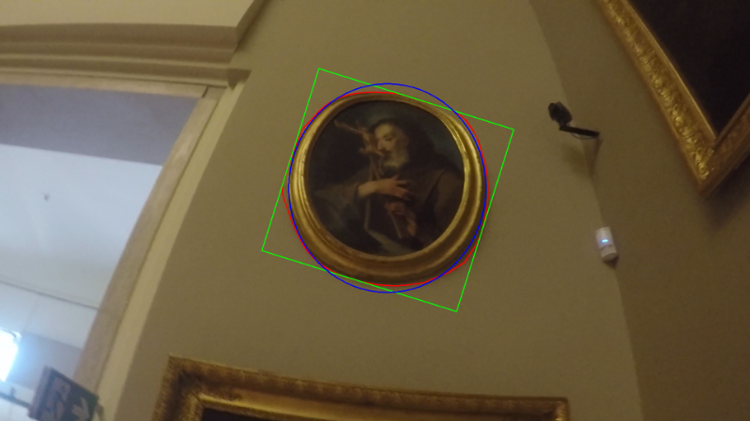
Painting detection - Is it a painting?
Shape
Number of points
Aspect ratio
Appearance
Histogram variance
Brightness
Area
Rotated box (1-2-3)
Ellipse (4)
Convex hull
1
2
3
4
Notes:
We make some checks on the shape, appearance and area of the contours (with thresholds in order to discriminate between what is painting and what is not-painting)
Shape
minimum number of points of convex hull
maximum aspect ratio of the bounding box
Appearance
minimum variance of the color histogram
maximum value of the 80-percentile of the grayscale histogram
Area
minimum rotated box area percentage with respect to the convex hull area (1-2-3)
minimum ellipse area percentage with respect to the convex hull area (4)
minimum convex hull area percentage with respect to the image area
minimum convex hull area percentage with respect to the largest convex hull found

Slide 4
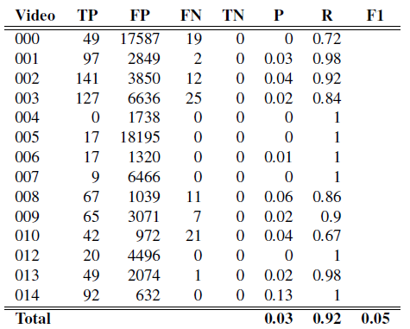
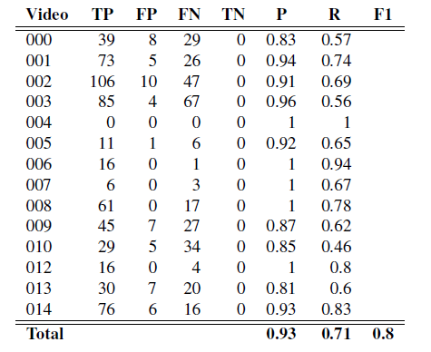
Painting detection evaluation
Without checks
With checks
- 23%
Notes:
These are the results for painting detection evaluation:
table 1 shows the results for step 1 (without checks)
table 2 shows the results for step 2 (with checks)
As we expected, we got very considerable increments in precision and f1 score, sacrificing a bit of recall
(the recall for step 1 is quite high and the precision is very low. Instead, in table 2 we can see that the precision has increased a lot, without sacrificing too much the recall)
Limitations:
paintings seen only partially (occluded or too much zoomed in)
paintings strongly in perspective
paintings overlapped with other artifacts of people
hyperparameters of checks are found experimentally (sub-optimal)

Slide 5
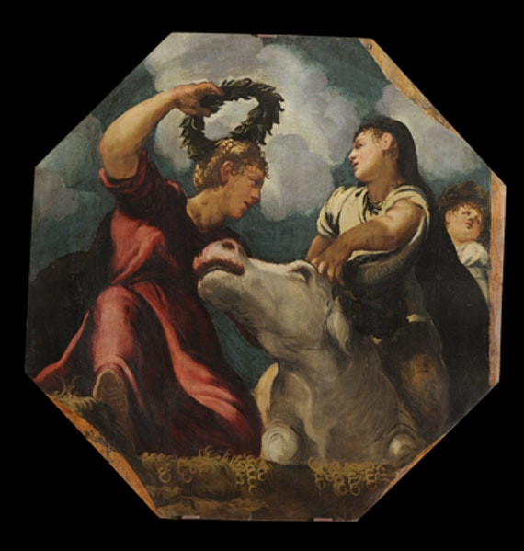
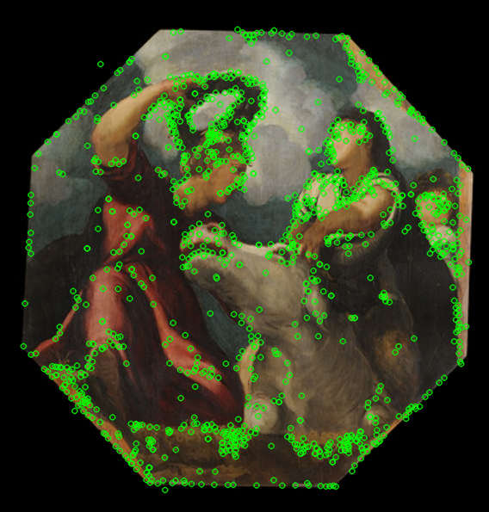
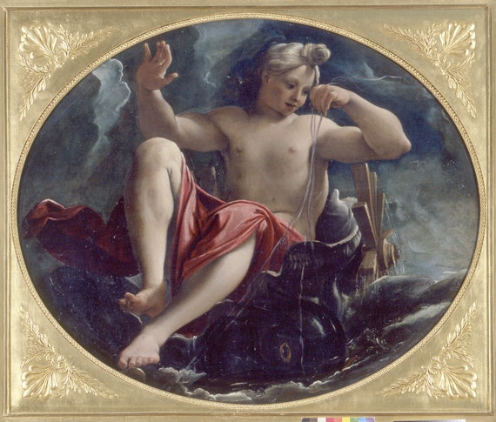
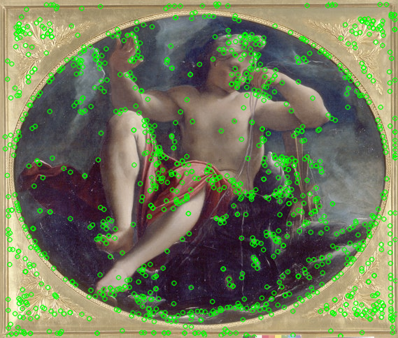
Painting retrieval (train)
Descriptors
Class
000_sift_1
0
000_sift_2
0
000_sift_3
0
kNN
classifier
Paintings_db
094_sift_1218
94
094_sift_1219
94
094_sift_1220
94
features_db.npy
img_features_db.npy
Notes:
For painting retrieval: first of all, we took all the paintings in the database and extracted the sift keypoints.
We built 2 lists: one with all the sift keypoint descriptors and the other with the painting ids associated with each sift.
We saved those 2 lists in 2 files.
Then, we trained a knn classifier (given a sift descriptor, it predict a painting id)

Slide 6
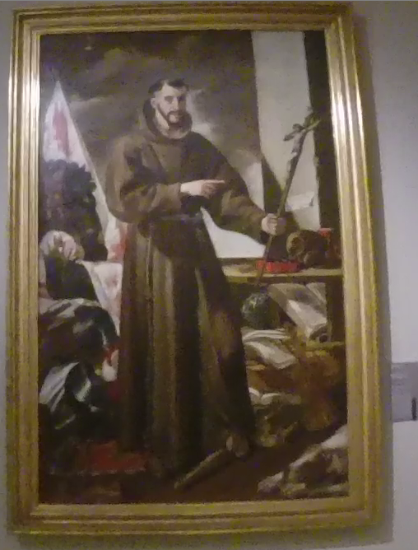
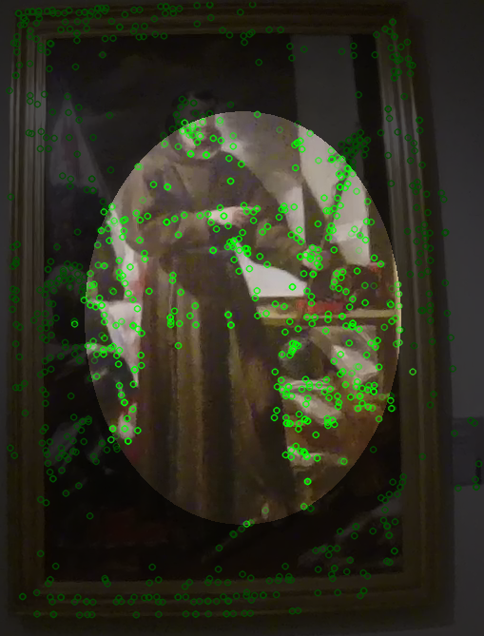
Painting retrieval (test)
test
76
50
test_sift_1
Frequency vector
Ranked list
76
test_sift_2
sorting indices by
frequency
test_sift_3
76
kNN
classifier
i=76
4
test_sift_389
76
test_sift_390
test_sift_391
6
(95, 1)
(95, 1)
76
(391, 1)
elliptical mask
test_sift
Notes:
At test time, we take a ROI and we compute the sift keypoints only for the central elliptical part of the image: this is done to avoid false detections over the border of the painting (later we’ll show the improvements given).
Then, for each keypoint descriptor, the knn classifier finds the most similar descriptor and return the corresponding painting id.
We compute the frequency vector and sorting the indices by frequency we obtain the ranked list of the painting ids, where the top1 should be the real painting.

Slide 7
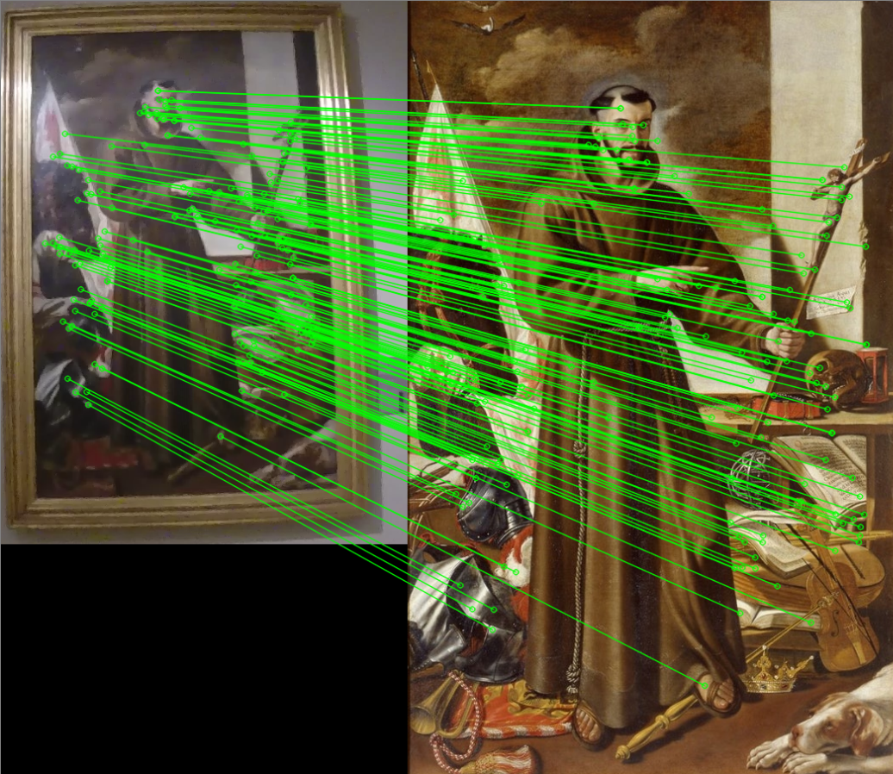
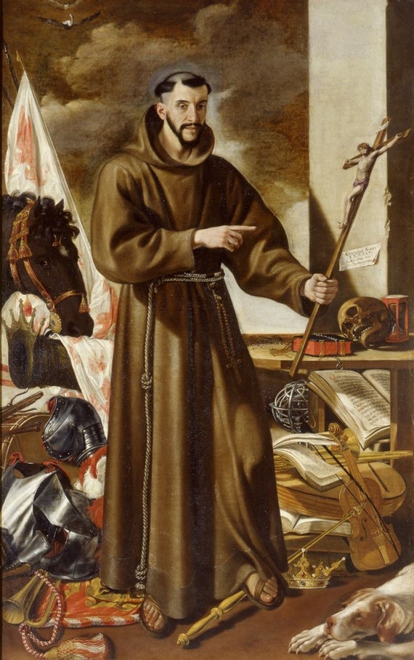
Painting retrieval (test)
test
SIFT matching
#matches > TH
Ranked list
OK
yes
76
top 1
no
-1
76
076.png
Ranked list
Notes:
Since many paintings are missing from the database, the top1 in the ranked list can be wrong, and so we wanted to identify this situation (also because we need to know this for painting rectification).
For this reason, we make an extra check: we compute the sift matches between the top1 and the test image.
If the number of matches is above a threshold, we can say that the top1 is actually the real painting, otherwise we insert a -1 in first position.
now my team mate cristian will show the painting retrieval results and conclude with the people detection and localitazion

Slide 8
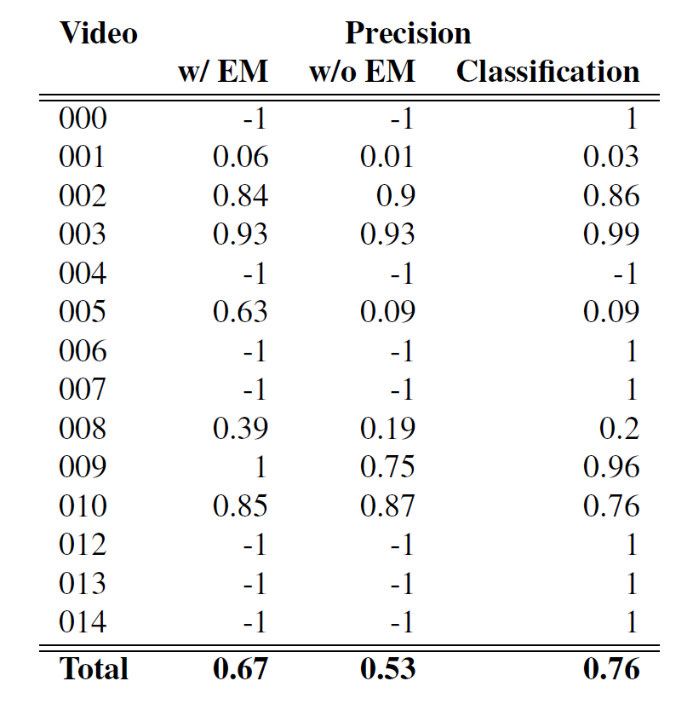
Painting retrieval evaluation
+ 26%
Notes:
These are the results for painting retrieval. As you can see the elliptical mask is very effective because we have an increment of the 26% of the precision.
The -1 means that for that video all the detections have ground truth equals to -1 (not in database) or there are no painting detections (like in video 4 that has only statues).
For the retrieval evaluation we used a rank scope of 5. The last column shows results for classification task and so we only look at the top1 in the ranking.

Slide 9
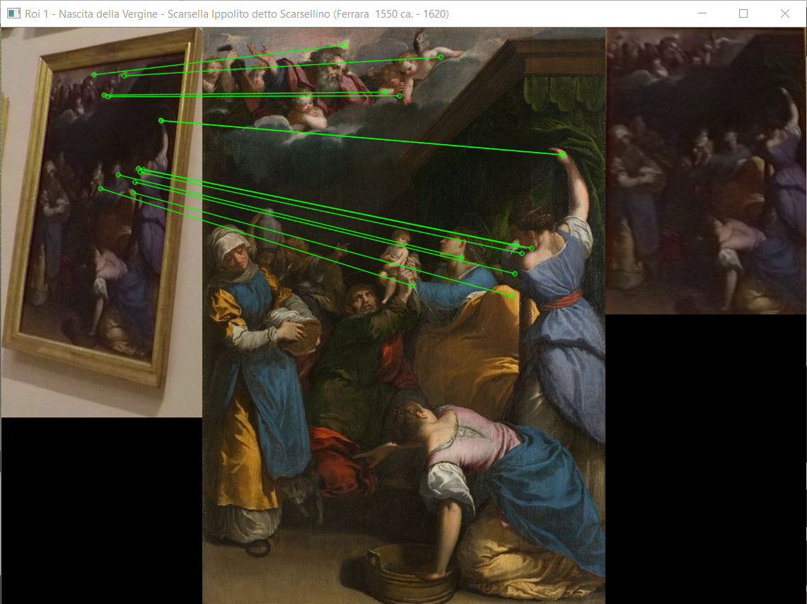
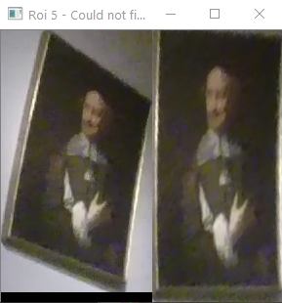
Painting rectification
RANK1 != -1
yes
SIFT points
-1
76
no
Vertex points
Ranked list
Notes:
For painting rectification, the system takes the ranked list from the retrieval and looks at the rank1 element. If it’s different from -1, the system takes the coordinates of the sift keypoints matches in order to obtain the homography transformation matrix. Otherwise, if it’s equal to -1, then we use a simpler approach that it’s effective on rectangular paintings but it does not preserve the proportions of the real painting: we extract the four corners coordinates from the contour in order to obtain the homography transformation matrix.

Slide 10
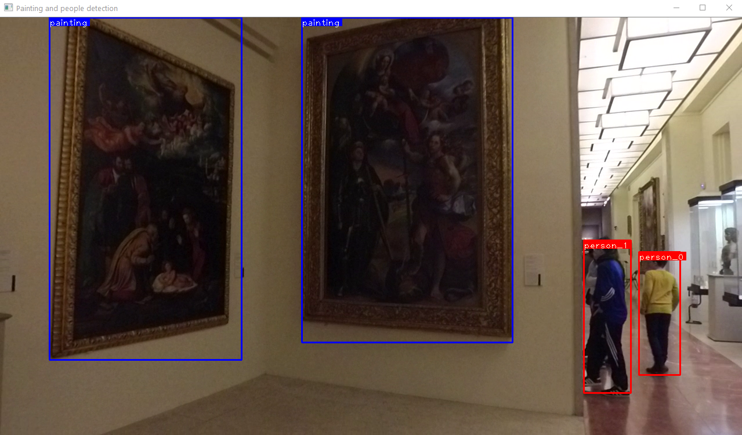
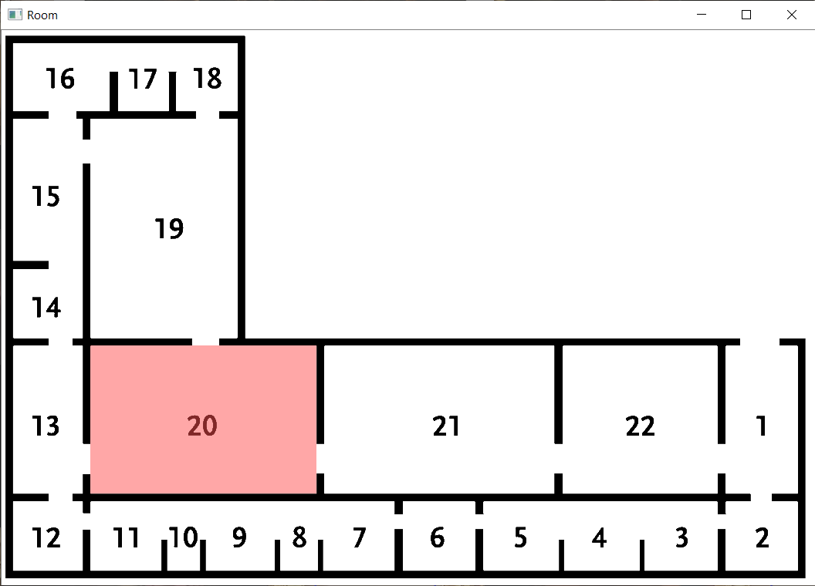
People detection and localization
YOLOv3 pre-trained
Threshold confidence
Remove people inside paintings
Retrieve paintings
Lookup in data.csv
Voting on room number
Notes:
For people detection, we used YOLOv3 pre-trained on Coco dataset. The only problem with YOLO is that it detects as people also some people in paintings and some statues. So, in order to remove people detections from paintings, we simply check if a person bounding box is completely inside a painting bounding box. In case the painting detection fails to detect a painting, we do another check: we take the confidence score returned by YOLO and if it’s lower than a threshold, we discard the detection. This check actually works quite well also for statues.
For the localization step, we take the retrievals of the paintings in a frame and we look up in data.csv to obtain the room. Then, we simply select the room by maximum voting, in order to prevent some possible errors in retrieval.

Slide 11
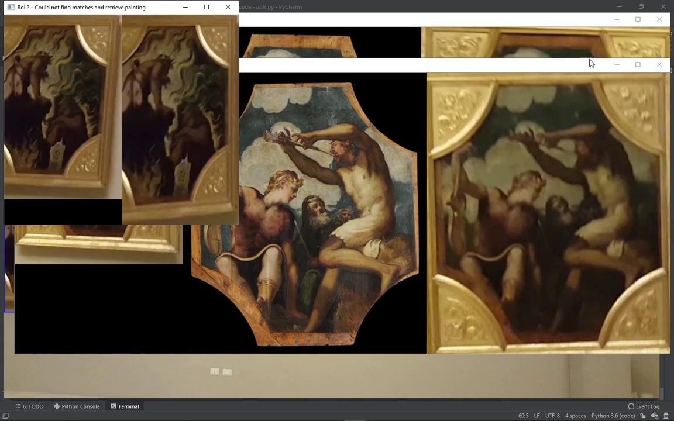
Demo
Notes:
dataset/videos/001/GOPR5826.MP4 (prima di zoom, detect + retreiv) 1
dataset/videos/002/20180206_114306.mp4 (da quando prende la persona in poi) 10
dataset/videos/002/20180206_114720.mp4 seconda metà del video (detec + people + retrieva) 5
dataset/videos/014/VID_20180529_113001.mp4 (tutto, detection) 15

